Slide 1

Pattern Seekers
Manufacturing Downtime

Slide 2



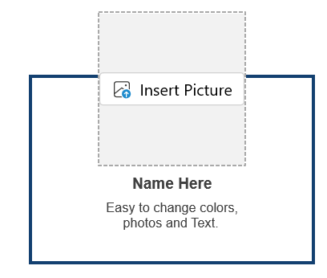
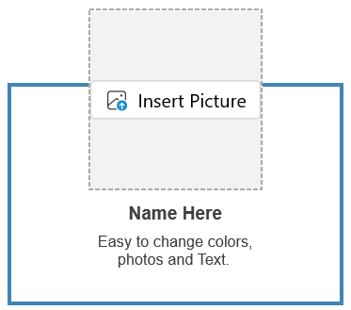




Our
Team
Abdelazim Mohamed
Mahmoud Abdellateif
Omar Gaber
Data Collection & Cleaning
Team Leader
Dashboard Design & Visualization
Data Analysis & KPI Development
& Presentation
esraa galal
Meryhan Makram
Samar Salah
Data Analysis & KPI Development
Data Collection & Cleaning
Dashboard Design & Visualization

Slide 3







Agenda

Slide 4



Slide 5



01
Project Overview
Business Case
The factory suffers from low quality and high defect rates.
Machine performance is unstable → causing production delays
The objective is to understand the root causes through data

Slide 6





01
Project Overview
Goals
Improve product quality and reduce defects
Increase machine efficiency and stability
Identify bottlenecks in the production line
Enhance OEE performance
Build a dashboard to support decision-making

Slide 7
Why this project matters
Even a small improvement in quality saves huge monthly cost
Management needs a clear vision of machine/production performance
Reducing waste directly increases profit
Better operations = more production without buying new machines

Slide 8


Slide 9


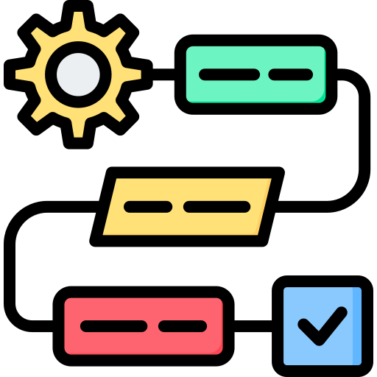

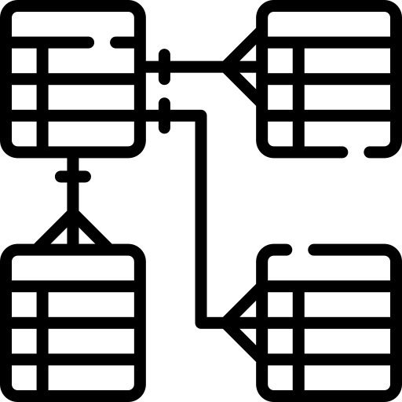
02
Technical Analysis Workflow
Data Flow
Raw Data
Cleaning
Processing
Modeling
Dashboard
Unorganized data collected directly from the source
Fixing errors, removing duplicates, and handling missing values
Transforming and organizing data into a usable structure
Applying analysis or algorithms to find patterns or predictions
A visual display of insights that supports quick decision-making

Slide 10




Architecture
Tools
Data layers
Final Reporting Layer
Excel
Processed Layer
Power BI
Python
Raw Laye
Data format used

Slide 11



Collection
production, quality, downtime, speed, machine type, product type
Includes
Daily / hourly readings
Frequency
Data collected from production lines and machines
Data

Slide 12
Cleaning
01
Removed duplicates
02
Fixed incorrect data types
03
Handled missing values
04
Outlier detection & correction
05
Standardized column names and formats

Slide 13
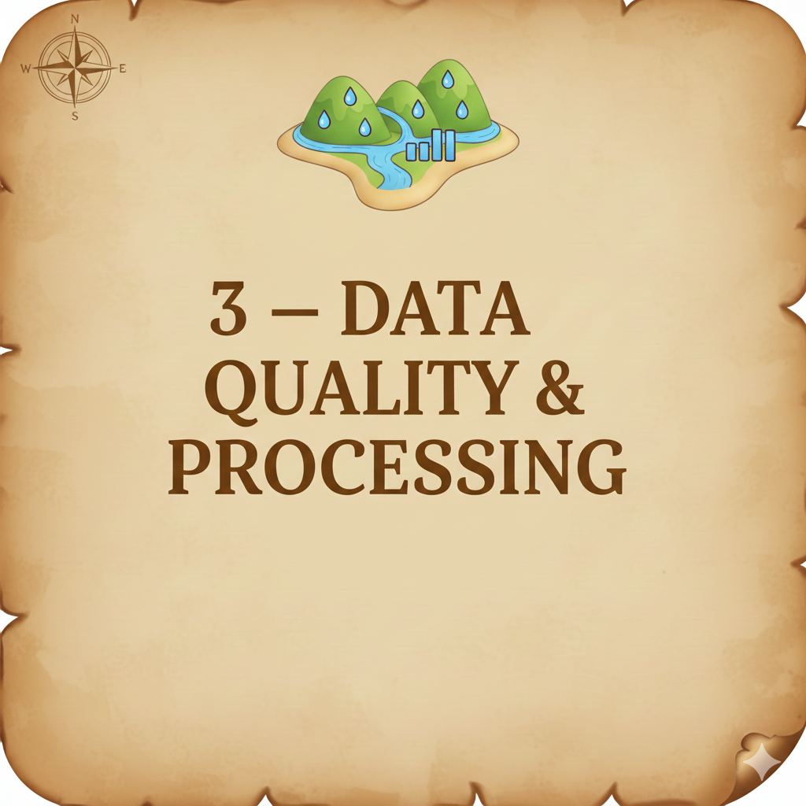

Slide 14



Assessment
Checked structure and schema of datasets
Verified data types and consistency
Data quality metrics
completeness
accuracy
uniqueness

Slide 15
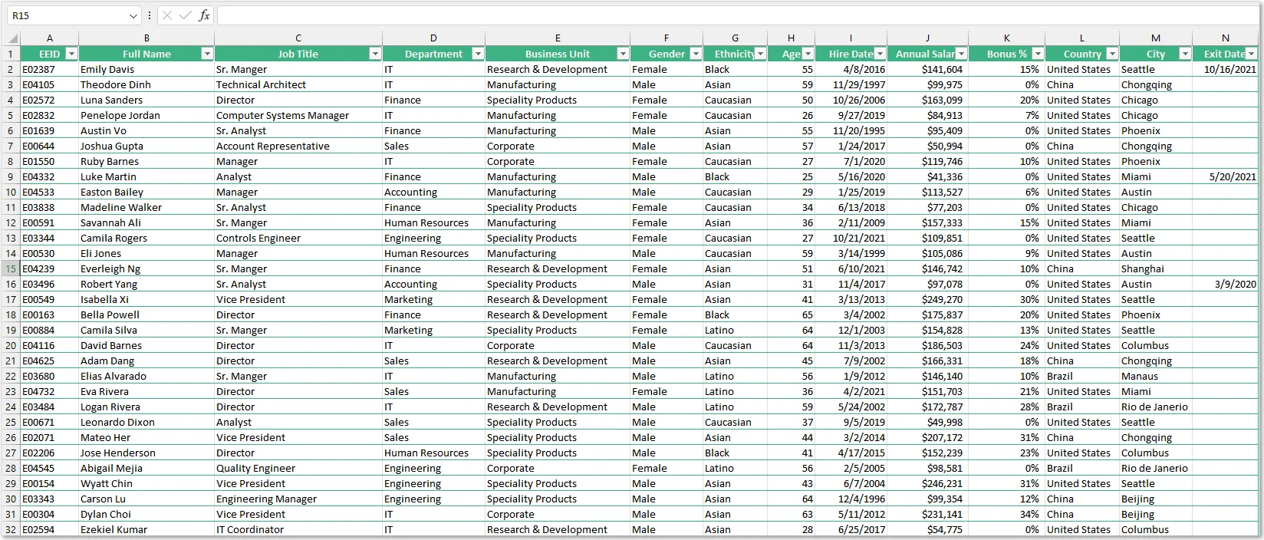



Missing Values
A
Identified missing data fields
B
Analyzed source (sensor failure, manual entry gaps)
Imputation techniques used
C
Mean / Median replacement
Forward fill
Row removal when appropriate

Slide 16

Outliers
Outliers detected in production numbers, speed, and quality
Techniques used: Boxplots, Z-score
Evaluated whether outliers represent errors or real behavior

Slide 17
Fixes
Corrected inaccurate entries
Replaced or capped extreme values
Improved field standardization & formatting consistency

Slide 18
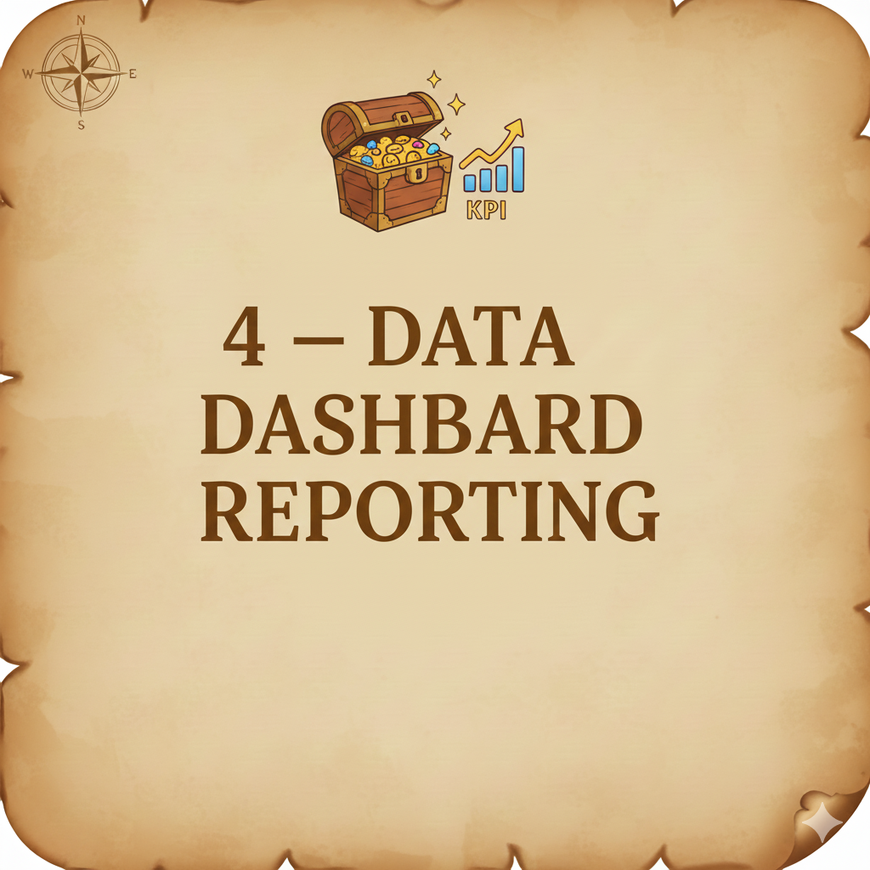

Slide 19
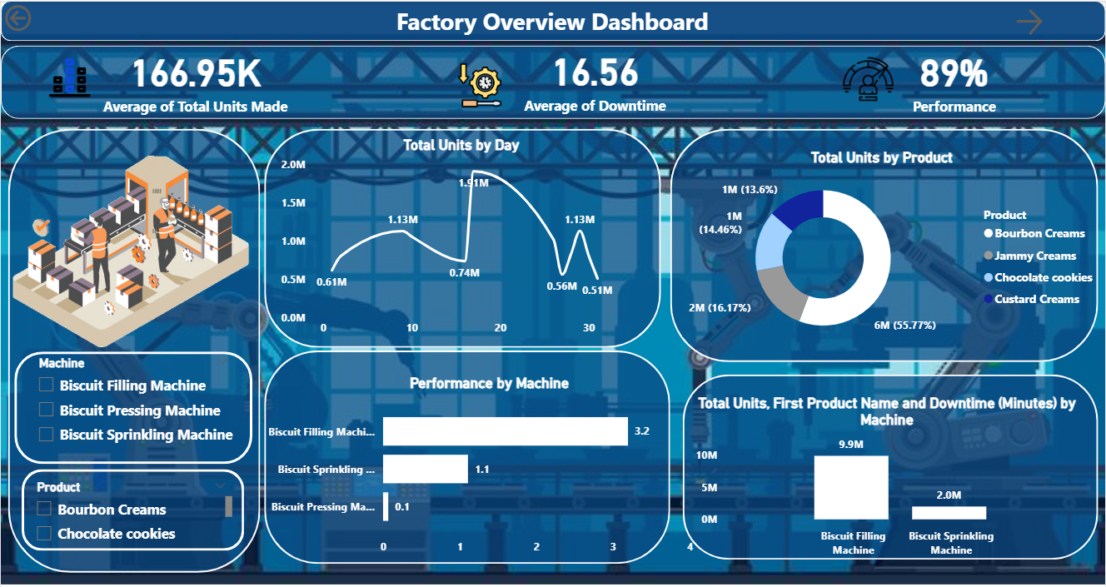
04
Dashboard & Reporting

Slide 20
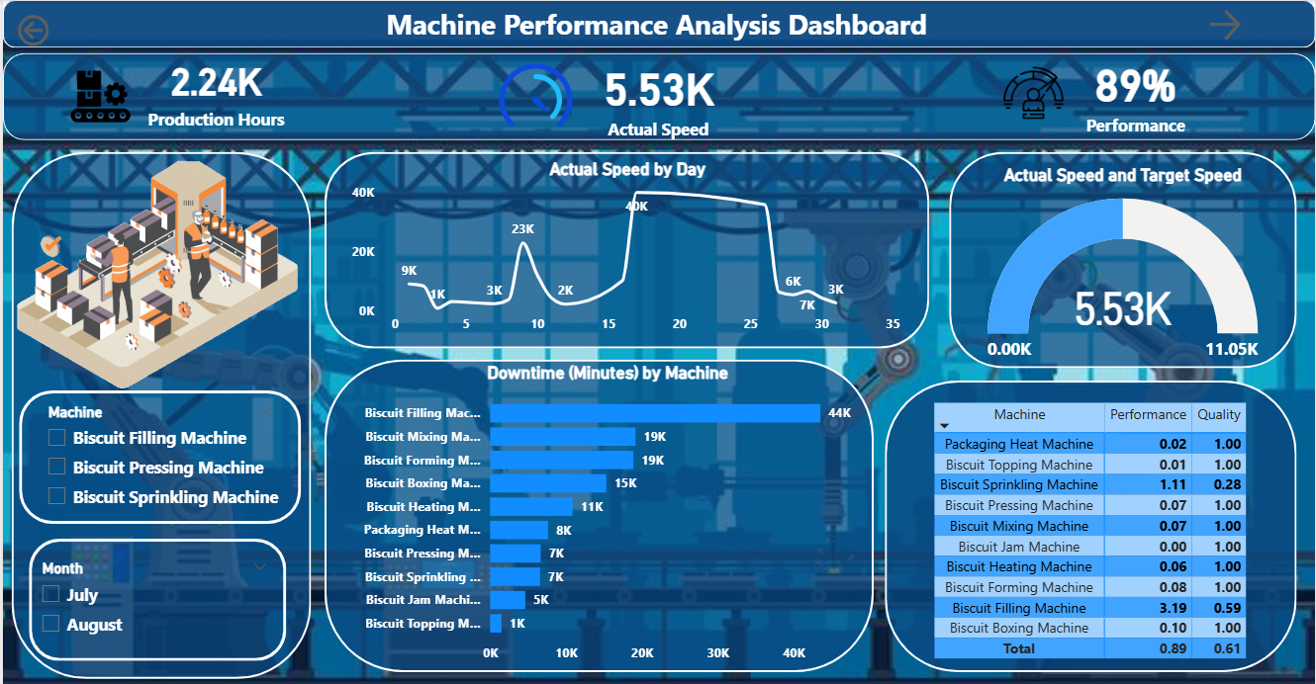

Slide 21
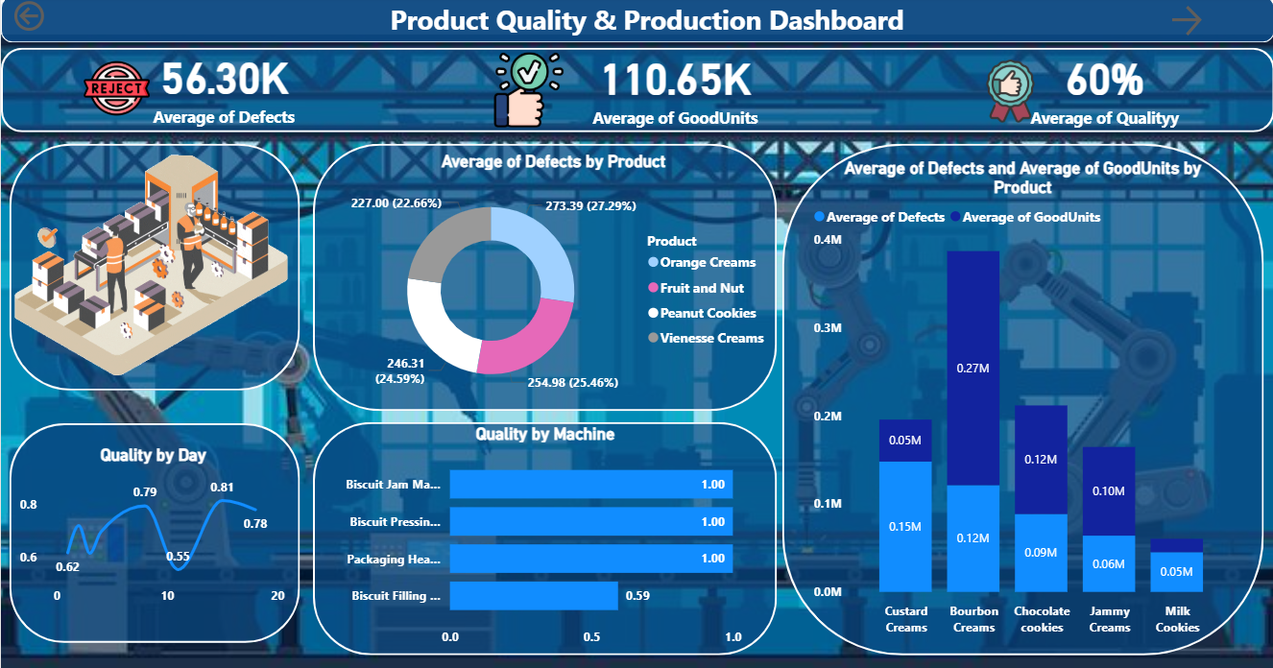

Slide 22
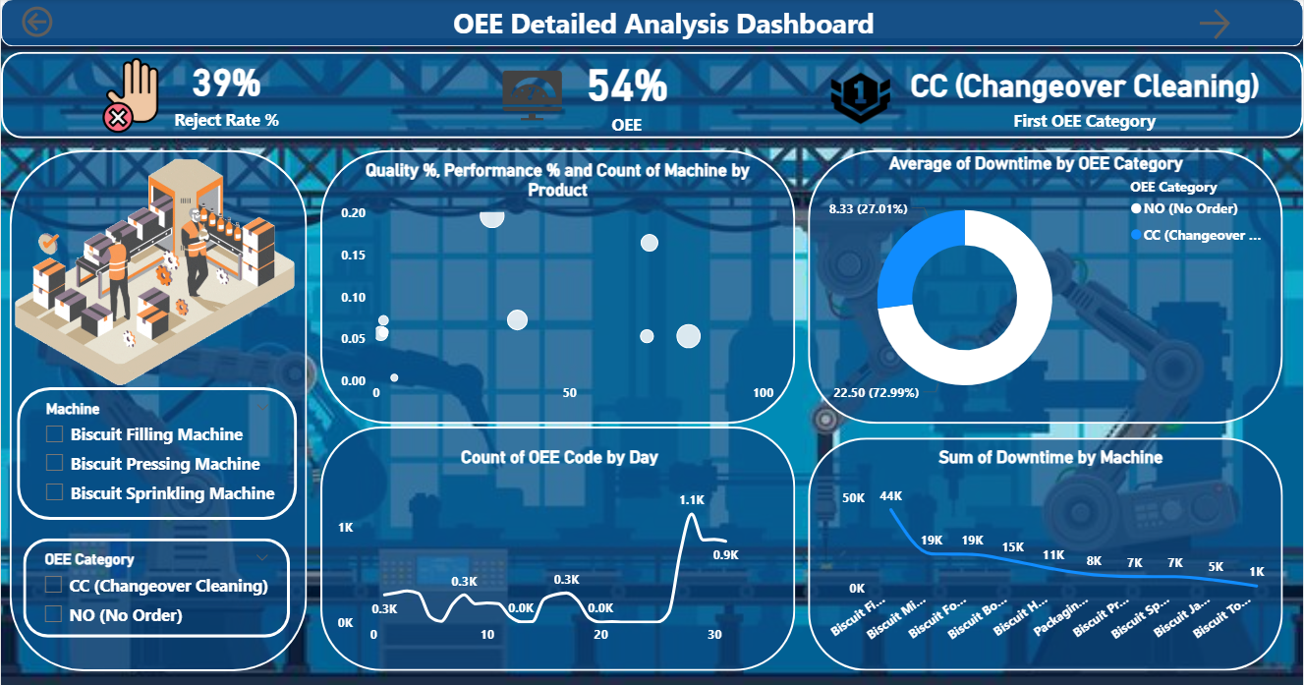

Slide 23
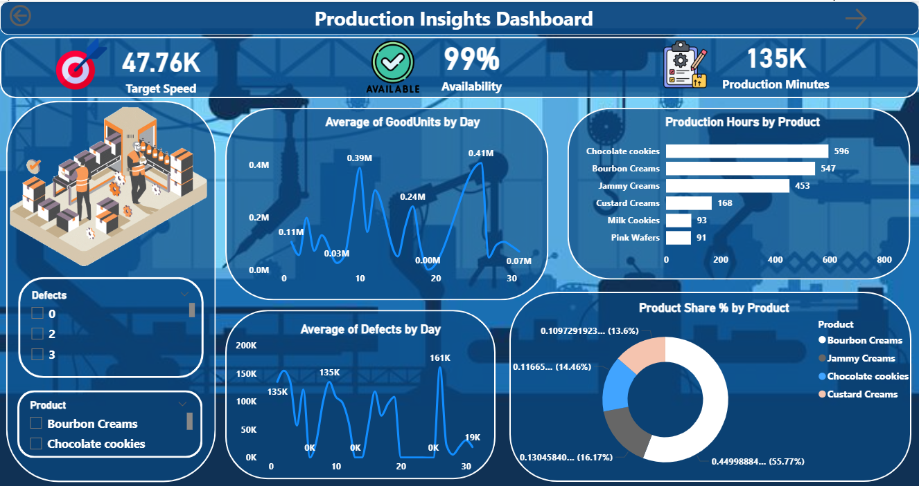

Slide 24


Slide 25





05
Recommendations & Next Steps
Recommendations
Introduce predictive maintenance schedule
Monitor actual vs target speed continuously
Focus maintenance on low-performance machine
Provide operator training to reduce human error
Implement stronger quality control checks

Slide 26
Integrate data into an ERP system
Add IoT sensors for real-time monitoring
Upgrade dashboard to automatic live refresh
Implement alert system when defect rate increases
Next Steps

Slide 27

Q&A

Slide 28
THANK YOU

